Slide 1
Application Booking a Trip.

Slide 2
Project Charter
Project purpose:
The main objective of this project is to store and inquire about travel reservations.
Large electronic reservation systems that sell tickets for many modes of transportation are known as Global Distribution Systems (GDS).
modern GDSs allow reservations for hotel rooms and rental cars, as well as airfare and train tickets in some countries.

Slide 3
Project Charter
•Business case for the project:
Ease of choosing hotels and direct booking for free without the need to leave the house and go to the tourism offices.
• Online booking is available to everyone without the need for any prior experience.
• The ability to search for more than one hotel at the same time and know the services of each hotel.

Slide 4
Project Charter
Speed ​​in response and immediate confirmation of booking via an instant message sent to your phone number that you registered with .
There is a rating for each hotel where you can read the review of any hotel before booking in it.
You can compare hotel prices with each other online and choose what is best for you in price and specifications.

Slide 5
Project Charter
Key deliverables of the project:
provide reservation and inquiry service for:
hotel rooms taxis (taxi)
Integrated tourism sea trips
Insurance Tourist city trips
Embassy trips Restaurant Reservations
Play tickets train tickets
Phrase luxury cars

Slide 6
Project Charter
Basic milestone timeline:
September: Gathering data for the project.
October and December: Developing
January: Test.
February: solve the problems and announce the program.
March: Install the system in company.

Slide 7
Project Charter
Benefits:
-Save time and make reservation faster.
-Increased customer volume for trips, hotels, etc.
-it is easy to know hotel premises and pricing.
Project resources:
1- A team of programing. 2- Device of receiver.
3-Budget: 500,000$. 4-Staff:organizers
5-Vendor:
Marketing companies and internet markets (like Android, Google play, hotels and company)

Slide 8
Project Charter
Budget:
500,000 $ (includes servers, project licenses, developers, Designers and training)
Constraints:
1-The project must take time less than 6monthes.
2-The project must not exceed 500,000 $.
3- The application must be bought from the company responsible for the trips.
Assumptions:
1- The project does not take more than 6monthes.
2- The cost no more 500,000$.

Slide 9
Project Charter
High –level risks:
You cannot get instant answers when dealing with an online booking site.
The degree of product differentiation is limited for travel agencies,
providing special information for some travel agencies To retain the best customers or offer special rates.

Slide 10
Project Scope
Project scope description:
It is an application you use to book the trip, including places and transportation so that you can book to your trip at home for any where.
You can use the app from any device.
You can pay for the trip through the app
The application can cancel the trip within 48 hours from the time of booking if

Slide 11
Project Scope
Project Acceptance Criteria:
-Beautiful user interface.
-Easy to use, faster and comfortable.
-It makes me easy to find places
-The app is equipped with GPs.
-The application is available on mobile app and Android, etc.
Project Deliverables:
Project plan, reports, documents and resources which return to the system
Saving money and time.

Slide 12
Project Scope
Project Exclusion:
One of customer requirements that the app show him the hotels and restaurants available every day, but the sponsor and manager refuse this request as it need a lot of time and cost.

Slide 13
Project constraints:
Budgeting of about $50,000 that cannot be increased during project implementation.
The project must be delivered three months from the specified time.
The project needs some smart devices.
Project Assumptions:
To use the application requires smart devices.
Now we are in an age of technology.

Slide 14
WBS
WBS:
1-Create Application
2-Development
3-Data collection
4-Requirment
5-Finishing

Slide 15
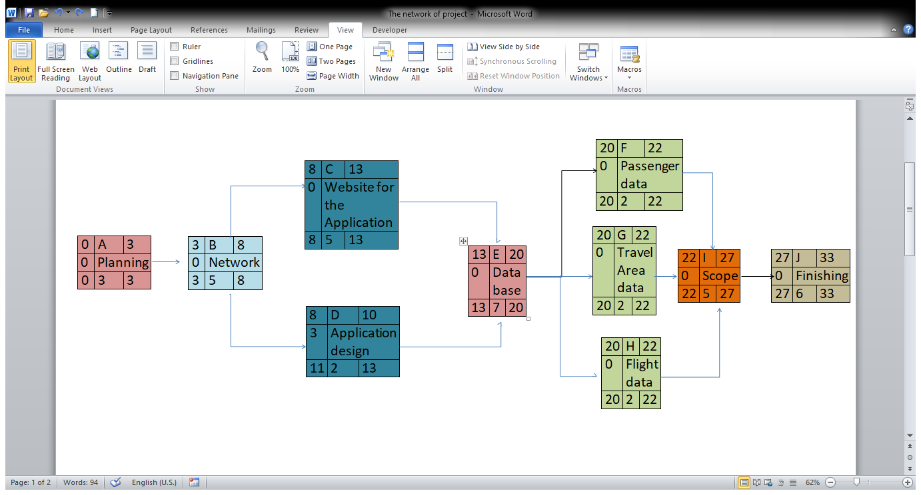
THE NETWORK

Slide 16
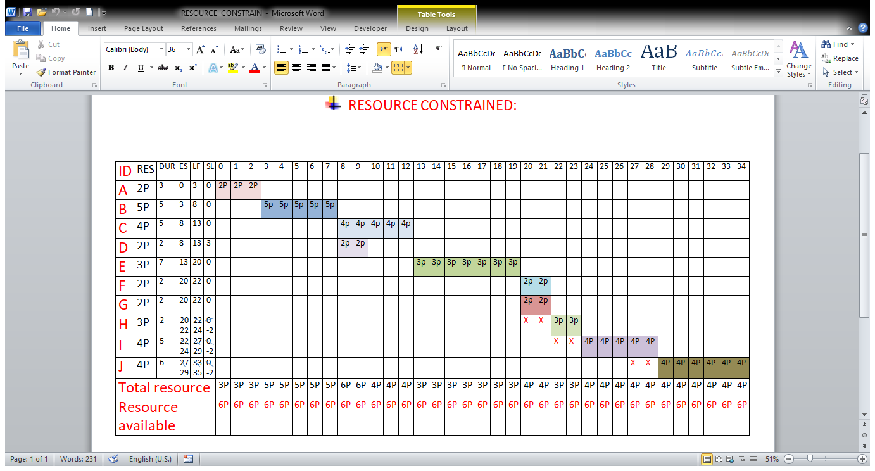
RESOURCE

Slide 17
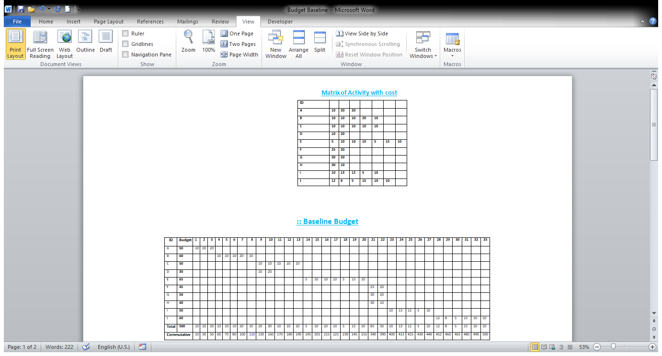
BUDGET

